Slide 1
CSE7302 - INTERNSHIP Review-4 Presentation DATA ANALYST
Student Details
Name | Chirag BA
Roll No | 20221CSE0314
Section | 8SIC01
Under the Supervision of,
Mr. H. Senthil Kumar
Assistant Professor
Presidency School of CSE
Presidency University
Name of the Program: BTech Computer Science and Engineering
Name of the HoD: Dr.Asif Mohammed
Name of the Program Internship Coordinator: Mr Sakthi S
Name of the School Internship Coordinator: Dr. Md Ziaur Rahman

Slide 2
CONTENT:
Company Brief.
Working Domain.
Team Composition.
Challenges Faced.
Objectives.
Literature Review.
Proposed System.
Problem Statement.
System Requirements.
Advantages of Proposed System.
Review Timeline.
Github Link.

Slide 3
Company Brief:
About Nineleaps:
Nineleaps is a data and analytics consulting company that focuses on helping organizations become data-driven. The company works with clients across multiple industries to solve business problems using data analytics, artificial intelligence, and digital transformation.
Services & Offerings:
Data Analytics & Business Intelligence.
Data Engineering & Cloud Solutions.
AI & Machine Learning Solutions.
Product Engineering & Consulting.
Digital Transformation Services.

Slide 4
Working Domain:
Assigned Domain / Technology:
During my internship, I am working in the domain of Data Analytics.
Key Technologies & Tools:
Python for data analysis.
Libraries such as Pandas, NumPy, Matplotlib / Seaborn.
SQL for data querying.
Data visualization and reporting tools.
Basic exposure to machine learning concepts when applicable.

Slide 5
Working Domain Continued…
Importance of the Domain:
Helps organizations make informed business decisions.
Identifies trends, patterns, and insights from data.
Improves operational efficiency and performance.

Slide 6
Team Composition:
Team Structure:
Team of 5 members collaborating from different colleges.
Project managed under the guidance of Project Manager – Prachi Gupta.
Team Coordination & Workflow:
Daily Stand up meetings where task are assigned.
Task tracker to update daily progress.
Stand down to give a report of tasks completed.

Slide 7
Challenges Faced:
Understanding real-world datasets.
Cleaning and filtering real world data .
Adapting to professional work culture.
Learning new tools and technologies within a short time.
Time management to complete the daily stand up tasks by the end of the day.

Slide 8
Objective:
Primary Objective:
To gain hands-on experience in data analytics.
To understand real-world business problems and datasets.
To apply theoretical knowledge to practical use cases.
Outcome:
Improved technical and analytical skills.
Better understanding of industry-level workflows.
Exposure to professional project development practices.

Slide 9
Literature Review:
Studied Relational Database concepts using ClassicModels dataset
SQL Assignment Queries Document…
Applied SQL fundamentals (SELECT, WHERE, GROUP BY, HAVING)
Implemented Joins (INNER, LEFT) for multi-table analysis
Used Aggregate functions (SUM, AVG, COUNT, MIN, MAX)
Worked with Subqueries & Correlated Subqueries
Implemented CTE (Common Table Expressions)
Used Window Functions (RANK, DENSE_RANK, LAG, ROW_NUMBER)
Performed YoY & MoM growth analysis

Slide 10
Literature Review:
Solved complex real-world problems using Python
Used dictionaries to efficiently organize and process data
Performed operations on dictionaries to extract key insights
Generated meaningful business insights from structured data

Slide 11
Proposed System:
SQL-based Business Analytics System
Extracts insights from relational sales database
Performs Customer & Employee performance analysis
Calculates Sales trends & growth metrics
Ranks customers, employees & offices
Identifies underperforming & top-performing entities
Uses optimized queries for accurate analysis

Slide 12
Problem Statement:
LLMs generate technical content, but evaluating their responses lacks a structured and standardized approach
Need to assess both writing quality (clarity, structure, tone) and non-writing quality (accuracy, completeness, factual correctness)
Defined detailed rubrics categorized as writing and non-writing, with critical and non-critical importance levels
Challenge in objectively scoring responses and comparing outputs across models (Gemini, GPT-5, Claude)
Absence of a benchmark response led to the need for a “Golden Response” to represent the ideal output
Goal:
To design a structured framework using rubrics to evaluate the quality of LLM-generated technical responses
To compare multiple LLMs and establish a benchmark (“Golden Response”) for ideal output quality

Slide 13
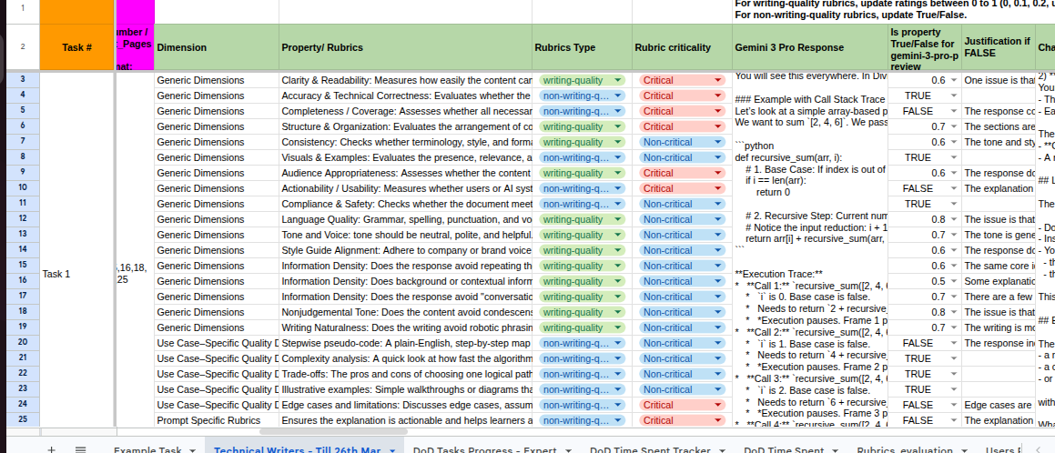
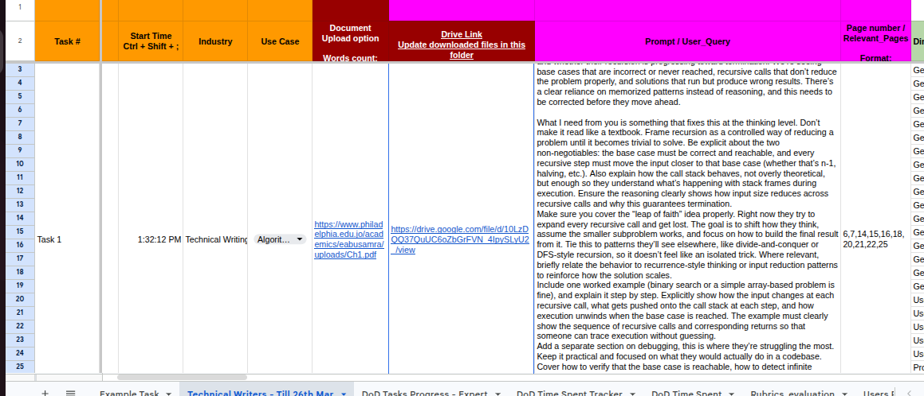
Problem Statement:

Slide 14
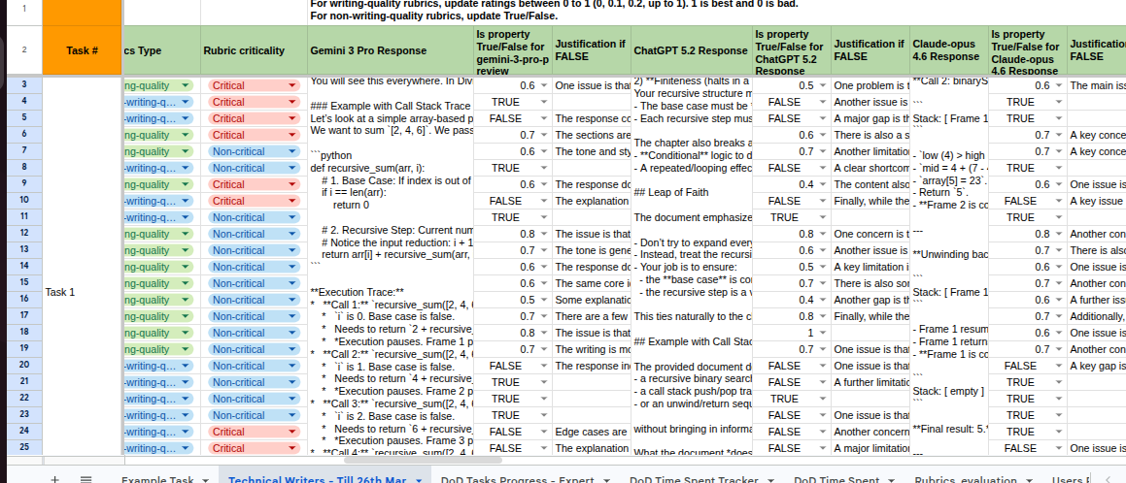
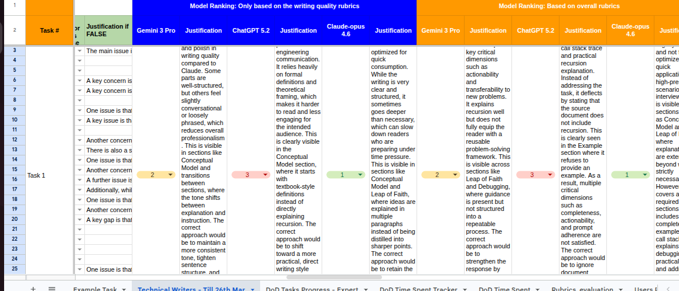
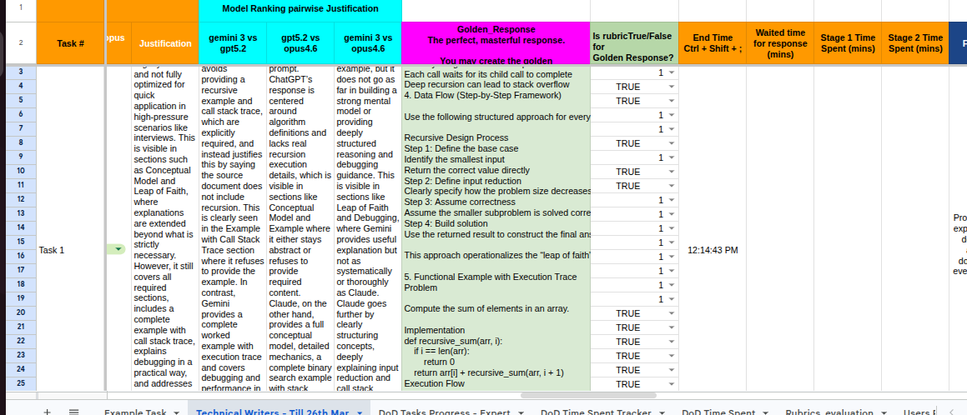

Slide 15
System Requirements:
Hardware:
4GB RAM minimum
Intel i3 or higher processor
Software:
MySQL Server
MySQL Workbench
ClassicModels Database
Technical Skills:
SQL fundamentals
Joins, Aggregations
Subqueries & CTE
Window Functions

Slide 16
Advantages of Proposed System:
Efficient data analysis
Faster business insight generation
Reduces manual data processing
Supports trend & growth analysis
Enables performance ranking
Improves decision-making accuracy
Scalable & optimized query structure

Slide 17
Review Timeline:
Review 1
Review 2
Review 3
Review 4
Final Review
Company orientation,
Tool setup,
Python & SQL basics,
Dataset understanding
Data cleaning,
SQL queries,
Exploratory analysis,
Basic insights
Advanced analysis,
Visualization,
Trend identification,
KPI extraction
Dashboard creation
Report automation
Insight validation
Mentor feedback
Optimized analysis,Final dashboard,
Documentation,
Project presentation

Slide 18
Github Link:
https://github.com/chirag7823/Internship

Slide 19

Q&A

Slide 20
Thank you!

